Slide 1

Stereo Vision:
Algorithms and Applications
Stefano Mattoccia
Department of Computer Science (DISI)
University of Bologna
stefano.mattoccia@unibo.it
www.vision.deis.unibo.it/smatt
January 12, 2013
Stefano Mattoccia

Slide 2
Updates
• Jan 2015: added new 3D applications
• Added details about our stereo camera with FPGA processing
• November 21, 2011: added experimental results for “Linear
stereo matching” (ICCV2011), Min et al’s algorithm (ICCV2011),
description of “Fast Segmentation driven (FSD)” (IC3D)
algorithm and description of SGM
• May 19, 2011: added experimental results of FBS on the GPU
[71] and the VisionSt stereo camera
• July 25, 2010: Linux and Windows implementations of the
Fast Bilateral Stereo algorithm available at:
www.vision.deis.unibo.it/smatt/fast_bilateral_stereo.htm
• April 20th, 2010: included descriptions and experimental
results for papers [67], [68], [69]
The latest version of this document is available here:
http://www.vision.deis.unibo.it/smatt/Seminars/StereoVision.pdf
Stefano Mattoccia

Slide 3
Outline
• Introduction to stereo vision
• Overview of a stereo vision system
• Algorithms for visual correspondence
• Computational optimizations
• Hardware implementation
• Applications
Stefano Mattoccia

Slide 4
What is stereo vision ?
• Is a technique aimed at inferring depth
from two or more cameras
• Wide research topic in computer vision
• This seminar is concerned with
• binocular stereo vision systems
• dense stereo algorithms
• stereo vision applications
• Emphasis is on approaches that are (or
might be hopefully soon) feasible for
real-time/hardware implementation
Stefano Mattoccia

Slide 5
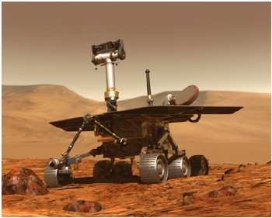
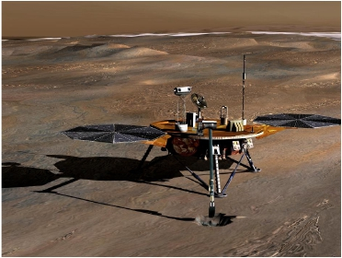
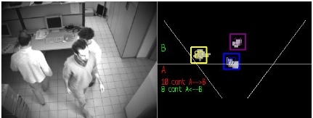
Applications
www.nasa.gov
www.nasa.gov
www.vision.deis.unibo.it/smatt/stereo
Stefano Mattoccia

Slide 6
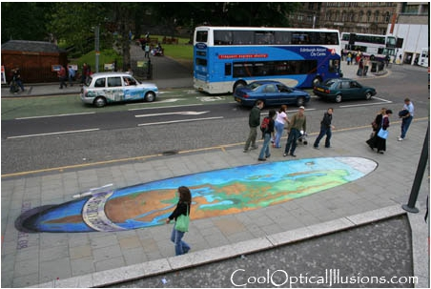
Single camera
• Both (real) points (P and Q)
project into the same image
point (p ≡ q)
• This occurs for each point
along the same line of sight
• Useful for optical illusions…
P
Q
π
p≡q
O
π: image plane
O: optical center
Courtesy of http://www.coolopticalillusions.com/
Stefano Mattoccia

Slide 7
Stereo camera
P
Q
πT
p≡q
OR
Reference R
πT
p ‘
q ‘
Target T
OT
With two (or more) cameras we can infer depth, by means of
triangulation, if we are able to find corresponding
(homologous) points in the two images
Stefano Mattoccia

Slide 8
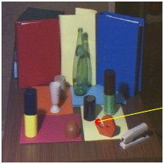
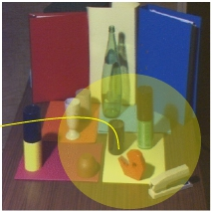
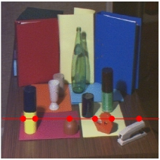
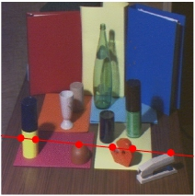
How to solve the correspondence problem ?
2D search domain ?
?
Reference (R)
Reference (R)
Target (T)
Target (T)
No!! Thanks to the
epipolar constraint
Stefano Mattoccia

Slide 9
Epipolar constraint
P
Q
πR
πT
p≡q
p
‘
q
‘
OR
Reference R
OT
Target T
• Consider two points P and Q on the same line of sight of
the reference image R (both points project into the same
image point p≡q on image plane πR of the reference image)
• The epipolar constraint states that the correspondence for
a point belonging to the (red) line of sight lies on the
green line on image plane πT of target image
Stefano Mattoccia

Slide 10
Stereo camera in standard form
P
Q
πR
πT
p≡q
p ‘
q ‘
y
y
OR
Reference R
OT
Target T
Once we know that the search space for corresponding points
can be narrowed from 2D to 1D, we can put (virtually) the
stereo rig in a more convenient configuration (standard
form) - corresponding points are constrained on the same
image scanline
Stefano Mattoccia

Slide 11
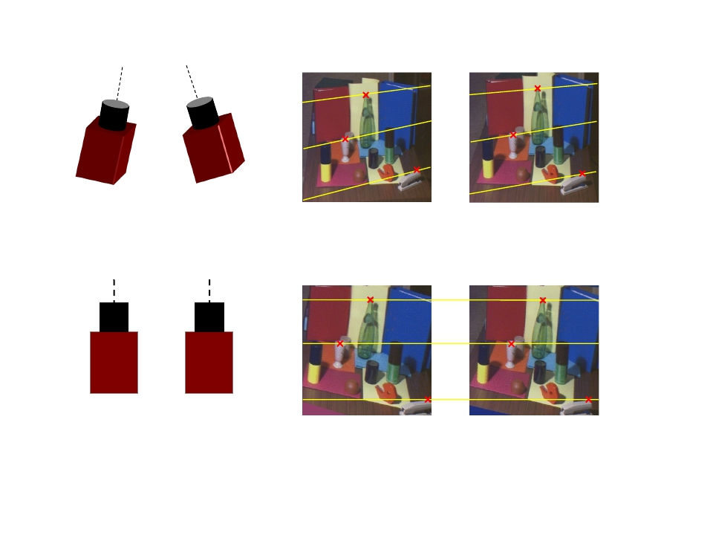
Original stereo pair
Stereo pair in standard form
Cameras are “perfectly” aligned
and with the same focal length
Stefano Mattoccia

Slide 12
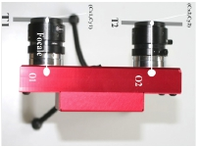
Disparity and depth
P
p
Z
p’
xR
xT
B (Baseline)
f
OR
OT
With the stereo rig in standard form and by considering
similar triangles (POROT and Ppp’):
b
Z
(b+xT)−xR
Z − f
b⋅ f
xR −xT
b⋅ f
d
=
Z =
=
xR −xT
is the disparity
Stefano Mattoccia

Slide 13
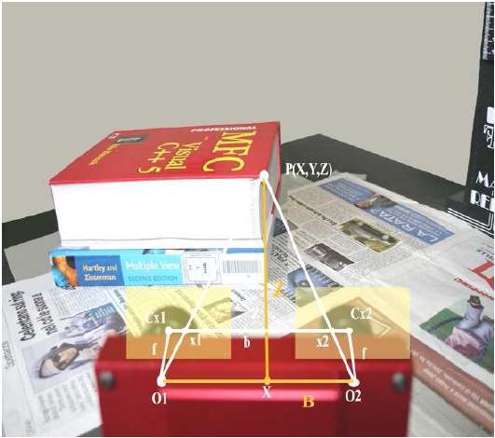
Disparity and depth
Stefano Mattoccia

Slide 14
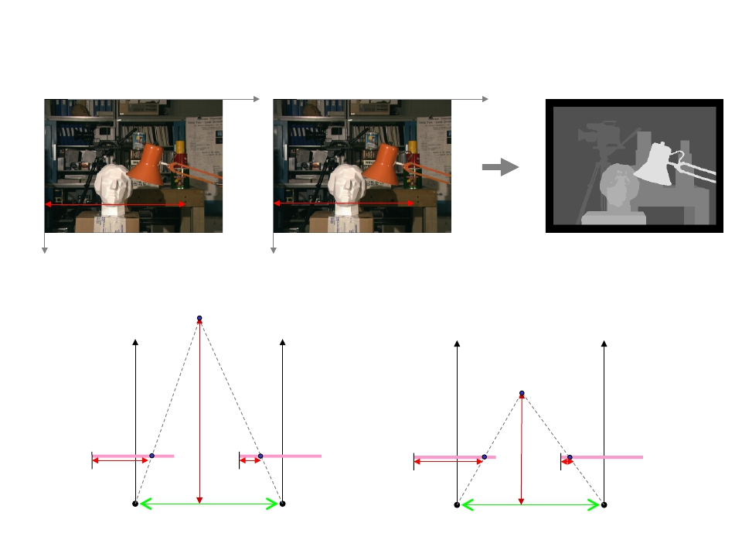
The disparity is the difference between the x coordinate of
two corresponding points; it is typically encoded with
greyscale image (closer points are brighter).
xR
xT
Reference
Target
Disparity map
Disparity is higher for points closer to the camera
P
P
p
xR
Z
p’
xT
p
Z
p’
xT
xR
OR
OT
OR
OT
Stefano Mattoccia
B
(Baseline)
B
(Baseline)

Slide 15
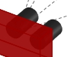
Range field (Horopter)
Given a stereo rig with baseline b and focal length f, the
range field of the system is constrained by the disparity
range [dmin, dmax].
Horopter
b⋅ f
b⋅ f
dmin
dmax
Stefano Mattoccia

Slide 16
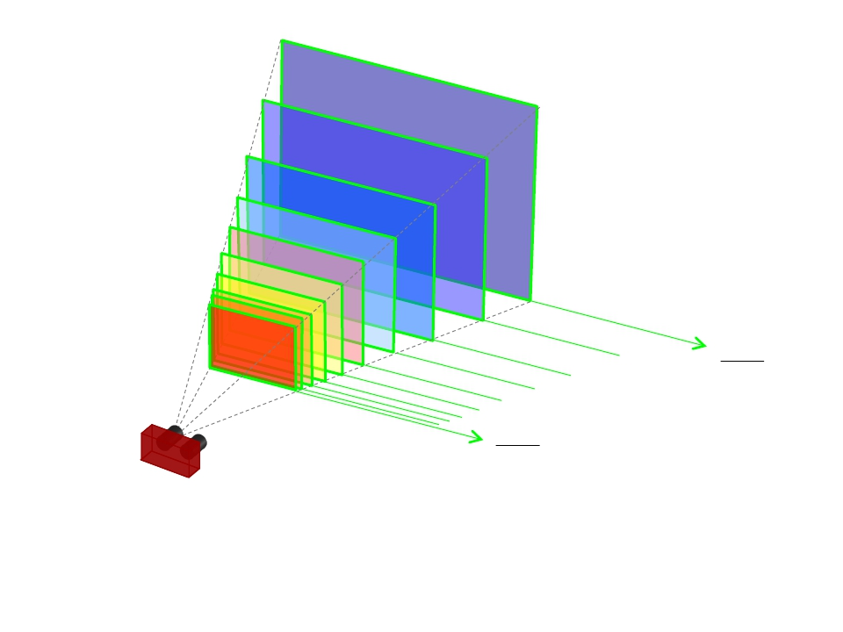
b⋅ f
dmin
b⋅ f
dmax
• Depth measured by a stereo vision system is discretized
into parallel planes (one for each disparity value)
• A better (virtual) discretization can be achieved with
subpixel techniques (see Disparity Refinements)
Stefano Mattoccia

Slide 17

b⋅ f
dmin
b⋅ f
dmin +4
• The range field (horopter) using 5 disparity values
[dmin, dmin+4]
Stefano Mattoccia

Slide 18
b⋅ f
Δ+dmin
b⋅ f
Δ+dmin +4
• Using 5 disparity values [Δ+dmin,Δ+dmin+4]
• With Δ>0, horopter gets closer and shrinks (depth
and obviously area/volume)
Stefano Mattoccia

Slide 19
Accuracy vs Resolution: quantitative analysis
Add here !
Stefano Mattoccia

Slide 20
Color or greyscale sensors ?
Insert here
Stefano Mattoccia

Slide 21
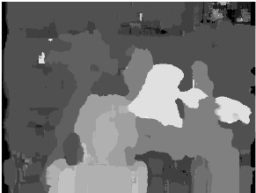
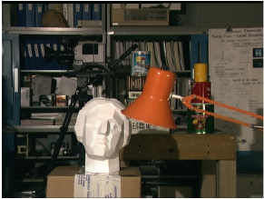
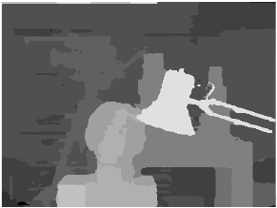
Key module in stereo vision?
The algorithm is crucial in this technology
Traditional
algorithm
State of the art
(e.g. ICCV 2011)

Slide 22
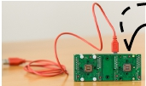
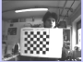
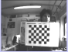
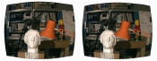
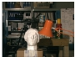
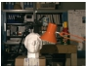
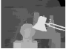
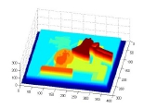
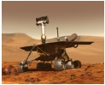
Overview of a stereo vision system
Calibration
(offline)
Rectification
Stereo
Correspondence
Triangulation
Intrinsic
and extrinsic
parameters
Stereo pair
Rectified stereo pair
Disparity map
Depth map
PC, FPGA
Stefano Mattoccia

Slide 23
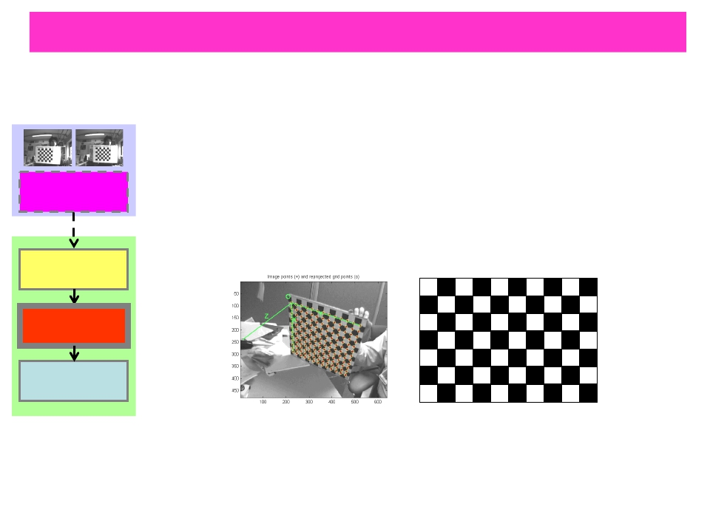
Calibration (offline)
Offline procedure aimed at finding:
• Intrinsic parameters of the two cameras
(focal length, image center, parameters
of lenses distortion, etc)
• Extrinsic parameters
Calibration
(offline)
(R and T that aligns the two cameras)
Rectification
Stereo
Correspondence
Triangulation
Calibration is carried out acquiring and
processing 10+ stereo pairs of a known
pattern (typically a checkerboard)
Stefano Mattoccia

Slide 24
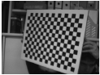
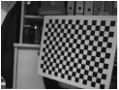
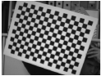
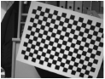
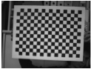
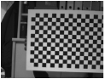
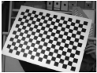
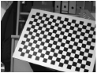
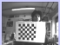
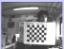
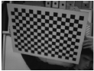
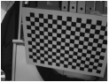
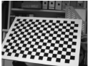
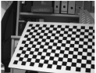
Calibration
(offline)
Rectification
• Calibration is available in OpenCV [39] and
Stereo
Matlab [40]
Correspondence
• A detailed description of calibration can be
Triangulation
found in [20,21,22]
• Next slides show 20 stereo pairs used for
calibrating a stereo camera
Stefano Mattoccia

Slide 25
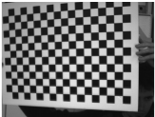
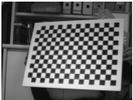
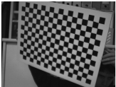
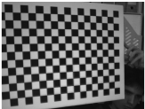
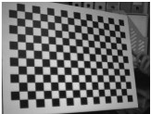
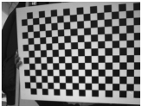
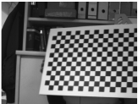
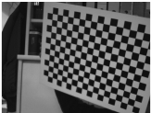
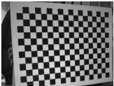











R
T
R
T
Stefano Mattoccia

Slide 26




















R
T
R
T
Stefano Mattoccia

Slide 27

Rectification
Using the information from the calibration step:
a) removes lens distortions
b) turns the stereo pair in standard form
Calibration
(offline)
Rectification
Stereo
Correspondence
Triangulation
Stereo camera in
standard form
Stefano Mattoccia

Slide 28



Stereo correspondence
Aims at finding homologous points in the
stereo pair.
Calibration
(offline)
Rectification
Stereo
Correspondence
Triangulation
disparity map
This topic will be extensively analyzed in
the next slides...
Stefano Mattoccia

Slide 29


Triangulation
Given the disparity map, the baseline and the
Focal length (calibration): triangulation
computes
the position of the correspondence in the 3D
Calibration
(offline)
space
d(x,y)
(X,Y,Z)
Rectification
Stereo
Correspondence
b⋅ f
d
Z =
Triangulation
xR
f
X = Z
y
f
Y = Z R
disparity map
depth map
Stefano Mattoccia

Slide 30
Datasets: stereo sequences
Sequences acquired with stereo cameras are available at:
http://www.vision.deis.unibo.it/smatt/stereo.htm
The datasets include:
• calibration parameters
• original sequences
• rectified sequences
• disparity maps
Stefano Mattoccia

Slide 31
Architectures
• Microprocessors
- Floating Point (FP) units + SIMD
- C/C++ (+ assembly)
- power,cost and size are the main drawbacks
• Low power & low cost processor
- C/c++
- no FP
- no SIMD (often)
• GPUs (Graphic Processing Units)
– raw power
- high power dissipation and cost
- programming is difficult (CUDA and OpenCL help)
• FPGA (Field Programmable Gate Array)
- efficient, low power (<1 W), low cost
- programming language: VHDL
- coding is difficult and tailored for specific devices
Stefano Mattoccia

Slide 32

Our custom FPGA-based stereo camera 1/3
• We have designed a real-time stereo camera with
depth maps computed according to state of the art
algorithms
• Details: www.vision.deis.unibo.it/smatt
• Youtube channel:
www.youtube.com/channel/UChkayQwiHJuf3nqMikhxAlw

Slide 33

Our custom FPGA-based stereo camera 2/3
• Processing at 30+ fps (640x480)
• Power consumption: < 2.5 Watt
• Self powered via USB cable
• Weight: < 80 g with lenses and holders

Slide 34



Our custom FPGA-based stereo camera 3/3
www.youtube.com/watch?v=KXFWIvrcAYo

Slide 35








Some available stereo cameras
www.videredesign.com
www.focusrobotics.com
www.ptgrey.com
www.visionst.com
FPGA/ASIC
DSP
www.nvela.com
www.valdesystems.com
www.tyzx.com
www.minoru3dwebcam.com
*
Stefano Mattoccia

Slide 36



Why is stereo correspondence so challenging ?
Next slides show
common pitfalls…
Stefano Mattoccia

Slide 37




Photometric distortions and noise
Specular surfaces
Stefano Mattoccia

Slide 38




Foreshortening
Uniqueness constraint ? :-(
Stefano Mattoccia

Slide 39




Perspective distortions
Uniform/ambiguous regions
?
?????
Stefano Mattoccia

Slide 40


Repetitive/ambiguous patterns
How to reduce ambiguity... ?
Stefano Mattoccia

Slide 41




Transparent objects
Occlusions and discontinuities 1/2
?
Stefano Mattoccia

Slide 42




Occlusions and discontinuities 2/2
?
Reference
?
Target
Target
Reference
Stefano Mattoccia

Slide 43
Middlebury stereo evaluation
The Middlebury stereo evaluation site [15] provides a framework
and a dataset (showed in the next slide) for benchmarking
novel algorithms.
Scharstein and Szeliski provide:
• a methodology for the evaluation of (binocular)
stereo vision algorithms [11]
• datasets with groundtruth [11,15,17,18,19]
• online evaluation procedure and ranking [15]
Datasets (with groundtruth) of stereo pairs affected by
photometric distortions are also available in [15].
[15] D. Scharstein and R. Szeliski, http://vision.middlebury.edu/stereo/eval/
[11] D. Scharstein and R. Szeliski, A taxonomy and evaluation of dense two-frame stereo correspondence algorithms
Int. Jour. Computer Vision, 47(1/2/3):7–42, 2002
Stefano Mattoccia

Slide 44
























Middlebury dataset (2003) [15]
Tsukuba, Venus, Teddy and Cones stereo pairs
Left
Right
Groundtruth
ALL
DISC
NON_OCC
D. Scharstein and R. Szeliski, http://vision.middlebury.edu/stereo/eval/
Stefano Mattoccia

Slide 45
The correspondence problem
According to the taxonomy proposed in [11] most stereo
algorithms perform (subset of) these steps:
1) Matching cost computation
2) Cost aggregation
3) Disparity computation/optimization
4) Disparity refinement
Local algorithms perform:
1 ⇒ 2 ⇒ 3 (with a simple Winner Takes All (WTA) strategy)
Global Algorithms perform:
1 (⇒ 2) ⇒ 3 (with global or semi-global reasoning)
Stefano Mattoccia

Slide 46
Pre-processing (0)
Sometime is deployed a pre-processing stage mainly to
compensate for photometric distortions.
Typical operations include:
• Laplacian of Gaussian (LoG) filtering [41]
• Subtraction of mean values computed in nearby pixels [42]
• Bilateral filtering [16]
• Census transform
[41] T. Kanade, H. Kato, S. Kimura, A. Yoshida, and K. Oda, Development of a Video-Rate Stereo Machine
International Robotics and Systems Conference (IROS '95), Human Robot Interaction and Cooperative Robots, 1995
[42] O. Faugeras, B. Hotz, H. Mathieu, T. Viville, Z. Zhang, P. Fua, E. Thron, L. Moll, G. Berry,
Real-time correlation-based stereo: Algorithm. Implementation and Applications, INRIA TR n. 2013, 1993
[16] A. Ansar, A. Castano, L. Matthies, Enhanced real-time stereo using bilateral filtering
IEEE Conference on Computer Vision and Pattern Recognition 2004
Stefano Mattoccia

Slide 47

The simplest (naive and unused) local approach:
Reference (R)
Target (T)
W
W
x
x
x+dmax
H
H
epipolar
y
line
Reference (R)
Target (T)
Stefano Mattoccia

Slide 48

• matching cost (1): pixel-based absolute difference
between pixel intensities
• disparity computation (3): Winner Takes All (WTA)
IR(x, y)−IT(x+d, y)
0
dmax
Winner d*
Groundtruth
d
Result
(disappointing)
Stefano Mattoccia
Reference

Slide 49

How to improve the results of the naive approach ?
Basically exist two different (not mutually exclusive)
strategies:
• Local algorithms use the simple WTA disparity selection
strategy but reduce ambiguity (increasing the signal to
noise ratio (SNR)) by aggregating matching costs over a
support window (aka kernel or correlation window).
Sometime a smoothness term is adopted. Steps 1+2 (+ WTA)
• Global (and semi-global*) algorithms search for disparity
assignments that minimize an energy function over the whole
stereo pair using a pixel-based matching cost (sometime the
matching cost is aggregated over a support). Steps 1+3
Both approaches assume that the scene is piecewise
smooth. Sometime this assumption is violated...
This hypothesis is implicitly assumed by local
approaches while it is explicitly modelled by
global approaches
* subset of the stereo pair
Stefano Mattoccia

Slide 50

Local approaches:
In order to increase the SNR (reduce ambiguity) the
matching costs are aggregated over a support window
Reference (R)
Target (T)
Global (and semi-global*) approaches:
Many algorithms search for the disparity assignment that
minimize a certain cost function over the whole* stereo
pair
E(d) = Edata(d)+Esmooth(d)
* subset of the stereo pair
Stefano Mattoccia

Slide 51


Matching cost computation (1)
IR(x,y)
IT(x,y)
Pixel-based matching costs
• Absolute differences
e(x, y,d) = IR(x, y)−IT(x+d, y)
R
T
• Squared differences
2
• Robust matching measures (M-estimators)
• Limit influence of outliers
• Example: truncated absolute differences (TAD)
e(x, y,d) = min{IR(x, y)− IT (x + d, y),T}
Stefano Mattoccia

Slide 52


• Dissimilarity measure insensitive to image sampling
(Birchfield and Tomasi [27])
BT helps at depth and color
discontinuities
Reference (R)
Target (T)
~
IT(xR +d,y)
~
IR(xR, y)
IT(xR +d, y)
IR(xR,y)
xR −1
xR +1
xR +d −1
xR +d
xR +d +1
xR
∋ !
~
~ ∃
e(xR, y,d) = min& min 1
!%xR−2≤x≤xR+2
IR(xR, y)−IT(x+d, y),
min
1
2
IT(xR +d, y)−IR(x, y)#
!∀
1
xR− ≤x≤xR+
1
2
Stefano Mattoccia

Slide 53

The Disparity Space Image (DSI) is a 3D matrix (WxHx(dmax-
dmin)
C(x,y,d)
likelihood/confidence
of each correspondence
Each element C(x,y,d) of the DSI represents the cost of
the correspondence between IR(xR,y) and IT(xR+d,y)
Stefano Mattoccia

Slide 54

Area-based matching costs:
S
• Sum of Absolute differences (SAD)
C(x,y,d) =∑ IR(x,y)−IT(x+d,y)
x∈S
• Sum of Squared differences (SSD)
2
x∈S
• Sum of truncated absolute differences (STAD)
C(x,y,d) =∑min{IR(x,y)−IT(x+d,y),T}
x∈S
Stefano Mattoccia

Slide 55
• Normalized Cross Correlation [57]
• Zero mean Normalized Cross Correlation [58]
• Gradient based MF [59]
• Non parametric [60,61]
• Mutual Information [30]
• . . .
• Combination of matching costs
Stefano Mattoccia

Slide 56
Add content here
Area-based matching costs
Stefano Mattoccia

Slide 57

Cost aggregation (2)
Let’s start by examining the simplest Fixed Window (FW)
cost aggregation strategy (TAD, disparity selection WTA)
Reference (R)
Groundtruth
Target (T)
Fixed Window (FW)
What’s wrong with FW ?
Stefano Mattoccia

Slide 58


FW (with WTA reasoning) fails in most points for the
following reasons:
c)
d)
b)
a)
Reference (R)
Target (T)
a) implicitly assumes frontal-parallel surfaces
b) ignores depth discontinuities
c) does not deal explicitly with uniform areas
d) does not deal explicitly with repetitive patterns
Stefano Mattoccia

Slide 59

a) FW implicitly assumes frontal-parallel surfaces
x
x
FW
Ideal
S
S
S
z
front view
z
front view
FW
Often violated in practice: top figure, slanted surfaces (down), etc.
x
x
FW
Ideal
S
z
front view
z
front view
Nevertheless, almost all state-of-the-art cost aggregation
strategies rely on the assumption that all the points
belonging to the support share the same disparity (only few
exceptions).
Stefano Mattoccia

Slide 60

b) FW ignores depth discontinuities
Implicitly assuming frontal-parallel surface in the real
scene is violated near depth discontinuities.
Background is
misaligned !
Aggregating the matching costs of two populations at
different depth (aligned foreground and misaligned
background (outliers)) results in the typical inaccurate
localization of depth borders.
S
FW
Robust matching measures (TAD) can partially reduce the
influence of outliers
Stefano Mattoccia

Slide 61

State-of-the-art cost aggregation strategies aim at shaping
the support in order to include only points with the same
(unknown) disparity.
S
S
FW
Ideal
For what concerns FW: decreasing the size of the support
helps in reducing the border localization problem.
However, this choice renders the correspondence problem more
ambiguous (especially when dealing with uniform regions and
repetitive patterns, see the next slide).
In practice, for the FW approach the choice of the optimal
size of the support is done empirically.
Stefano Mattoccia

Slide 62

FW does not deal explicitly with ambiguous regions -
uniform areas c) and repetitive patterns d)
S
S
FW
FW
Ideal
Ideal
S
S
In both cases an ideal cost aggregation strategy should
extend its support in order to include as much points at
the same (unknown) depth as possible.
Stefano Mattoccia

Slide 63
Quite surprisingly, in spite of its limitations, FW is widely
adopted in practice (probably it is the most frequently used
algorithm for real applications).
• Easy/fast implementation
• Fast, thanks to incremental calculation schemes
• Runs in real-time on standard processors (SIMD)
• Has limited memory requirements
• Hardware implementations (FPGA) run in real-time
with limited power consumption (<1W)
Before analyzing more sophisticated approaches let s consider
two optimization techniques used by FW and other algorithms:
• Integral Images (II)
• Box-Filtering (BF)
Stefano Mattoccia

Slide 64

Optimization: Integral Images
(aka Summmed Area Table)
x
H
I(x,y)
y
W
• Straightforward extension to stereo
(2 images)
S(x, y)= ∑I(i, j)
i<x, j<y
S 2(x, y)= ∑I 2(i, j)
i<x, j<y
F. Crow, Summed-area tables for texture mapping, Computer Graphics, 18(3):207–212, 1984
Stefano Mattoccia

Slide 65

Optimization: Box-Filtering 1/2
Left
2n+1
2n+1
Right
y
y+1
2n+1
y
y+1
2n+1
x
x+d
n
SAD(x, y,d) =
∑ L(x+ j, y +i)− R(x+d + j, y +i)
i, j=−n
SAD(x, y+1,d) = SAD(x, y,d)+U(x, y+1,d)
n
∑ L(x+ j,y+n+1)−R(x+d + j,y+n+1)
j=−n
n
∑ L(x+ j,y−n)−R(x+d + j,y−n)
j=−n
U(x,y+1,d)=
−
M. Mc Donnel. Box-filtering techniques. Computer Graphics and Image Processing, 17:65–70, 1981
Stefano Mattoccia

Slide 66

Optimization: Box-Filtering 2/2
SAD(x, y+1,d) = SAD(x, y,d)+U(x, y+1,d)
n
d ∈[0..dmax]
n
U(x,y+1,d)=
∑ L(x+ j,y+n+1)−R(x+d + j,y+n+1)
j=−n
−
∑ L(x+ j,y−n)−R(x+d + j,y−n)
j=−n
Left
2n+1
2n+1
Right
y-n
A
B
y-n
A'
B'
y
Y+1
2n+1
y
Y+1
2n+1
y+n+1
D
C
y+n+1
D'
C'
x-n-1
x
x+n
x+d-n-1
x+d
x+d+n
U(x, y+1,d)=U(x−1, y+1,d)+ A− A' − B−B' + C−C' − D−D'
SAD(x, y+1,d)= SAD(x, y,d)+U(x−1, y+1,d)+ A− A' − B−B' + C−C' − D−D'
Stefano Mattoccia

Slide 67
Box-Filtering Vs Integral Images
- Both require 4 operations per point
- Integral images can handle supports of different size
- Integral Images has overflow issues
(for example, with int32 and S2 ⇒ WxH<256x256)
- Integral images is more demanding in terms of memory
requirements. For single images:
WxHxsizeof(data_type) Vs ≈ Wxsizeof(int32) for S2
In practice, integral images may be convenient when
supports of different size are required.
Extension of box-filtering to more complex shapes was
proposed in [47].
Stefano Mattoccia

Slide 68

Optimizations:
Single Instruction Multiple Data (SIMD)
a
Op b
Scalar computation 1 Op
It s a computation paradigm that that allow for processing
with the same operation multiple data in parallel.
A
SIMD
Op
16 Ops in
parallel !
B
• Several computer vision algorithms are suited for SIMD
• SIMD features are available in most current processors
• Intel processors SIMD available since Pentium (MMX)
• SIMD mapping is difficult (assembly)
Stefano Mattoccia

Slide 69
Single Matching Phase Algorithm [48,49]
• Image type: grayscale
• Preprocessing: subtraction of mean values
• Matching cost (Step 1): Absolute Differences
• Aggregation strategy (Step 2): FW
• Disparity selection (Step 3): WTA
• Outlier detection: efficient strategy (later, Step 4)
• Discards uniform areas: yes, analyzing image variance
• Optimizations: box-filtering + SIMD instructions (SSE)
• Sub-pixel interpolation up to 1/16 of pixel (later)
• Runs in real-time on a standard PC
L. Di Stefano, M. Marchionni, S. Mattoccia, A fast area-based stereo matching algorithm
Image and Vision Computing, 22(12), pp 983-1005, October 2004
L. Di Stefano, M. Marchionni, S. Mattoccia, A PC-based real-time stereo vision system
Machine Graphics & Vision, 13(3), pp. 197-220, January 2004
Stefano Mattoccia

Slide 70

How far can we go with more effective
(frontal parallel) cost aggregation strategies ?
We made an experiment computing ideal frontal parallel
supports using the ground truth.
With 43x43 max support, TAD and a WTA strategy:
Results (errors in red)
There is room for improvements...
Stefano Mattoccia

Slide 71


• Compared to pixel-based approaches the support aggregation
(potentially) allows for improving robustness
• An ideal (frontal parallel) cost aggregation strategies
should include in the support only points with similar
disparity:
• expanding in regions at similar depth (left)
• shrinking near depth discontinuities (right)
Stefano Mattoccia

Slide 72


What about symmetric/asymmetric support,
discontinuities and occlusions ?
• (Unknown) Occlusions and discontinuities play a central
role for support aggregation strategies. The next slides
depict relevant cases using a simple object laying on a
planar background
• Occlusions and discontinuities are strictly related
Stefano Mattoccia

Slide 73




Case 1: no half occlusion, no discontinuity
Stefano Mattoccia

Slide 74




Case 2: near half occlusion vs inside
discontinuity
Stefano Mattoccia

Slide 75




Case 3: inside half occlusion vs any -> depth = occlusion !!
?
Stefano Mattoccia

Slide 76




Case 4: near half occlusion vs near discontinuity
Stefano Mattoccia

Slide 77




Case 5: no half occlusion, no discontinuity
Stefano Mattoccia

Slide 78




Case 6: near discontinuity, near occlusion
Stefano Mattoccia

Slide 79




Case 7: inside discontinuity, near occlusion
Stefano Mattoccia

Slide 80




Case 8: near discontinuity, no occlusion no discontinuity
Stefano Mattoccia

Slide 81


Case 9: inside occlusion vs any -> depth = occlusion !!
?
Stefano Mattoccia

Slide 82




Case 10: near occlusion and discontinuity vs near discontinuity
Stefano Mattoccia

Slide 83




Case 11: near discontinuity vs near discontinuity
Stefano Mattoccia

Slide 84




Case 12: near discontinuity vs near discontinuity and occlusion
Stefano Mattoccia

Slide 85


Classification and evaluation of cost
aggregation strategies for stereo correspondence
• In [1] we classified, implemented and evaluated (accuracy
and execution time) 10+ state-of-the-art cost aggregation
strategies
• Since the focus is on the cost aggregation strategy the
evaluation methodology includes only DISC and NON_OCC
F. Tombari, S. Mattoccia, L. Di Stefano, E. Addimanda, Classification and evaluation of cost aggregation methods for stereo
correspondence, IEEE International Conference on Computer Vision and Pattern Recognition (CVPR 2008)
Accompanying web site and software: www.vision.deis.unibo.it/spe/SPEHome.asp
Stefano Mattoccia

Slide 86
• Analyzed a subset of relevant state-of-the-art cost
aggregation strategies
•
•
•
•
position
shape
position and shape
weights
• Most of these techniques compute the support using a
symmetric strategy
• Benchmarking platform: Intel Core Duo 2.14 GHz CPU
• Execution time: Teddy stereo pair (size 450x373) with
and a disparity search range of 60.
• Optimizations: the same proposed by authors*, no SIMD,
no multicores, etc
• The next slides describe most of these methods and some
novel approaches not included in the paper (i.e. Fast
Aggregation [64], Fast Bilateral Stereo (FBS) [65] and
the Locally Consistent (LC) methodology [66])
Stefano Mattoccia

Slide 87




Fixed Window: results
Stefano Mattoccia

Slide 88

Shiftable Windows [11]
• This approach aims at reducing the border localization
problem of FW not constraining the support to be centered
on the central position
• Support is symmetric
• Execution time: 12 sec
The position with the best score
is selected
S
R
T
D. Scharstein and R. Szeliski, A taxonomy and evaluation of dense two-frame stereo correspondence algorithms
Int. Jour. Computer Vision, 47(1/2/3):7–42, 2002
Stefano Mattoccia

Slide 89




Shiftable Windows: results
Stefano Mattoccia

Slide 90

Multiple Windows [7]
• The number of elements in the support is constant
• The shape of the support is not constrained to be rectangular
• Support is symmetric
• Proposed for 5, 9 and 25 sub-windows (5W, 9W and 25W)
• Execution time (9W): 11 sec (*)
With 9 sub-windows (9W):
+ 4 out of
according to the matching cost computed
S
over the single sub-windows
H. Hirschmuller, P. Innocent, and J. Garibaldi, Real-time correlation-based stereo vision with reduced border errors
Int. Journ. of Computer Vision, 47:1–3, 2002
Stefano Mattoccia

Slide 91

S
R
T
Support: some shapes (with 9 sub-windows)
Stefano Mattoccia

Slide 92




Multiple (9) Windows: results
Stefano Mattoccia

Slide 93

Variable Windows [12]
• Pixel-based cost function: Birchfield and Tomasi
• Size of the support varies while shape is constrained (square)
• Position of the support changes (shiftable windows)
• Support is symmetric
• Efficient search based on a DP technique
• Execution time: 16 sec (good trade-off speed/accuracy)
S
R
T
O. Veksler, Fast variable window for stereo correspondence using integral images
In Proc. Conf. on Computer Vision and Pattern Recognition (CVPR 2003), pages 556–561, 2003
Stefano Mattoccia

Slide 94

∑e
d (i, j)
S
cardinality of the support
e =
i, j∈S
This term favors large
β
S +γ
windows in uniform areas
(where e+α ⋅var(e) is
small)
Cd(S)= e+α ⋅var(e)+
α,β,γ
: parameters of the algorithm
Stefano Mattoccia

Slide 95




Variable Windows: results
Stefano Mattoccia

Slide 96


Segmentation
Original
Segmented [50]
• Partitioning of the image in regions made of connected
pixels with similar colors intensity
• Useful in stereo for cost aggregation, disparity refinement,
outliers detection, etc
D. Comaniciu and P. Meer, Mean shift:Arobust approach toward feature space analysis!
IEEE Transactions on PatternAnalysis and Machine Intelligence, 24:603–619, 2002
Stefano Mattoccia

Slide 97
Segmentation based [5]
• Assumption: depth within each segment varies smoothly
• Segmentation of reference image (Not Symmetrical)
• Shape and size unconstrained (within max support)
• Pixel-based cost function: M-estimator
• Requires explicit segmentation
• Each cost is weighted 1 (same segment) or
λ<<1 (different segment)
• Execution time: 2 sec (fast)
M. Gerrits and P. Bekaert, Local Stereo Matching with Segmentation-based Outlier Rejection
Proc. Canadian Conf. on Computer and Robot Vision, 2006
Stefano Mattoccia

Slide 98

λ
λ
λ
λ
λ
λ
λ
λ
λ
λ
λ
λ
λ
λ
1
λ
λ
λ
λ
λ
λ
λ
1
1
1
1
λ
λ
λ
1
1
1
1
1
1
λ
λ
1
1
1
1
1
1
1
1
1
1
1
1
1
1
1
1
1
1
1
1
1
1
1
1
1
1
λ
1
1
1
1
1
1
1
1
1
1
λ
1
1
1
λ
1
λ
1
1
1
1
1
1
1
1
1
1
1
1
1
1
1
1
1
1
1
1
1
1
1
1
1
1
1
1
1
1
1
1
1
1
1
1
1
1
1
1
1
1
1
1
1
1
1
1
1
1
1
1
1
1
1
1
1
1
1
1
1
1
1
1
1
1
1
1
1
1
1
1
1
1
1
1
1
1
1
1
1
R
T
For each point within the maximum allowed support:
• points within the same segment of the central point
(reference image) assume weight 1
• points outside are weighted λ<<1
S
S
R(Seg)
R
R
Stefano Mattoccia

Slide 99




Segmentation based: results
Stefano Mattoccia

Slide 100




Bilateral Filtering [51]
• Edge preserving smoothing technique
• In the sum each element is weighted
according to its spatial and color
proximity (wrt the central point)
• Implicitly deploys segmentation
Weight function
Original
image
Conventional
smoothing
Bilateral
Filtering
C. Tomasi and R. Manduchi. Bilateral filtering for gray and color images. In ICCV98, pages 839–846, 1998
Stefano Mattoccia

Slide 101

Adaptive Weights [14]
• Costs are symmetrically weighted
by spatial and color proximity
• Implicitly deploys segmentation
• Pixel-based cost function: TAD
• Symmetric support
• Execution time: 17 minutes (very slow)
p
q
WR
WR
R
WT
S
T
WT
Simplified example (using only color proximity)
K. Yoon and I. Kweon. Adaptive support-weight approach for correspondence search IEEE PAMI, 28(4):650–656, 2006
Stefano Mattoccia

Slide 102

pi
pc
WR
qi
qc
WT
∑wr(pi, pc)⋅wt(qi,qc)⋅TAD(pi,qi)
pi∈WT,qi∈WT
∑wr(pi, pc)⋅wt(qi,qc)
pi∈WR,qi∈WT
C(pc,qc)=
dp(pi,pc)
γ p
dc(IR(pi),IR(pc))
γc
−
−
wR(pi, pc)=e
e
dp(qi,qc)
γ p
dc(IR(qi),IR(qc))
γc
−
−
wT(qi,qc)=e
e
Stefano Mattoccia

Slide 103




Adaptive Weights: results
Stefano Mattoccia

Slide 104




Stefano Mattoccia

Slide 105

Segment Support [10]
• Segments both images
• Discard the spatial proximity assumption: weights
rely only on segmentation and color proximity
• Cost function: TAD
• Symmetric support
• Execution time: 30 minutes (very slow)
Weights for reference (and target) image are assigned
according to:
pi
pc
1.0 for pi ∈Sc
−
Sc segment that
includes the
central point
,otherwise
'
wR(pi, pc)=
dc(IR(pi),IR(pc))
e
γc
WR
and then combined (symmetric support)
F. Tombari, S. Mattoccia, L. Di Stefano, Segmentation-based adaptive support for accurate stereo correspondence
IEEE Pacific-Rim Symposium on Image and Video Technology (PSIVT 2007)
Stefano Mattoccia

Slide 106

Depth borders
Adaptive weights
Planar regions
Adaptive weights
Ideal vs Segment Support
Ideal vs Segment Support
Stefano Mattoccia

Slide 107

Repetitive patterns
R
T
Adaptive weights
T
Ideal vs Segment Support
Stefano Mattoccia

Slide 108




Segment Supports: results
Stefano Mattoccia

Slide 109

Fast Aggregation [64]
• Assumption: depth within each segment varies smoothly
• Cost function: TAD
• Segments only the reference image R
• Asymmetric support (reference image)
• Support extends to the entire segment (R)
• Fast: 0.6 sec (segmentation accounts for 40%-80%)
p
Sp
R
q
WP
r
Sp
r
S
T
F. Tombari, S. Mattoccia, L. Di Stefano, E. Addimanda, Near real-time stereo based on effective cost aggregation
International Conference on Pattern Recognition (ICPR 2008)
Stefano Mattoccia

Slide 110
CS(p,q,d) CW(p,q,d)
Cagg(p,q,d)=
+
Sp
r2
CS p(p,q,d)=
CW p(p,q,d)=
∑TAD(pi,qi+d
pi∈Sp
∑TAD(pi,qi+d
pi∈Wp
)
)
• Cw tries to avoid
segment locking
• Cw may help
in highly textured regions (small
segments)
• However, Cw may introduce artifacts (discontinuities)
since aggregation is performed on a fixed window
Stefano Mattoccia

Slide 111




Fast Aggregation: results
Stefano Mattoccia

Slide 112
Fast Bilateral Stereo framework (FBS) [65]
• Symmetric support
• Combines accuracy of adaptive weights approaches with
efficiency of traditional (correlative) approach
• Deploys a regularized range filter computed on a block
basis of size wxw
• Increase noise robustness
• Efficient pixel-wise cost computation by means of
integral-image/box-filtering schemes
• Results comparable to top performing approaches
Segment Support and Adaptive Weights
• Fast: 32 sec on Teddy (w=3)
• Moreover, several trade-off speed vs accuracy are
feasible: 14 sec (w=5) , 9 sec (w=7), 5 sec (w=9)
S. Mattoccia, S. Giardino,A. Gambini, Accurate and efficient cost aggregation strategy for stereo correspondence based on
approximated joint bilateral filtering, Asian Conference on Computer Vision (ACCV2009)
www.vision.deis.unibo.it/smatt/fast_bilateral_stereo.htm
Stefano Mattoccia

Slide 113

• The range filter is computed on a block-basis deploying
the average value within the block
• To avoid inaccurate localization of the discontinuities
the central point is kept as reference
• Spatial filter computed on block basis
x
x+d
w
w
y
W
Three supports computed
by Fast Bilateral Stereo
W
Stefano Mattoccia

Slide 114




FBS (w=3) vs Adaptive Weights (AW)
FBS
AW
Stefano Mattoccia

Slide 115




Fast Bilateral Stereo: results (w=3, w=5)
w=3
w=5
Stefano Mattoccia

Slide 116




Fast Bilateral Stereo: results (w=7, w=9)
w=7
w=9
Stefano Mattoccia

Slide 117
Fast Bilateral Stereo on the GPU [71]
• The local nature of the FBS algorithm allows to
exploit parallel capabilities available in GPUs
• Compared to a single core CPU, on the Middlebury
dataset, the implementation of FBS with CUDA enables
to obtain:
• 70X speed-up on an NVIDIA GEForce 460 GTX GPU
• 100X speed-up on an NVIDIA Tesla C2070 GPU(*)
The measured execution time, with parameters w=3 and
W=19, is (Teddy stereo pair): 300 ms for the GEForce 460
GTX and 200 ms on the Tesla C2070
Detailed results available in:www.vision.deis.unibo.it/smatt/FBS_GPU.html
(*) We acknowledge with thanks NVIDIA for the donation of the Tesla C2070
S. Mattoccia, M. Viti, F. Ries,. Near real-time Fast Bilateral Stereo on the GPU, 7th IEEE Workshop on Embedded Computer
Vision (ECVW20011), CVPR Workshop, June 20, 2011, Colorado Springs (CO), USA

Slide 118

Fast Segmentation-driven (FSD)
• Applies the SS strategy on a block basis
• Results equivalent to SS much more quickly (comparable
to FBS)
• Compared to AW and FBS is effective also with greyscale
images
S. Mattoccia, L. De-Maeztu, A fast segmentation-driven algorithm for fast and accurate stereo correspondence, IC3D 2011

Slide 119



35
30
25
20
15
10
5
0
b=3
Execution time (seconds)
Teddy 1 core
Teddy 4 cores
Tsukuba 1 core
Tsukuba 4 cores
3
b=5
5
Block size (b pixels)
7
b=7

Slide 120
Locally Consistent (LC) stereo [66]
• Exploits the mutual relationships among neighboring
pixels by explicitly modeling the continuity
constraints
• Very accurate (significant improvements near depth
discontinuities and low textured regions)
• Notable improvements compared to state-of-the-art
approaches
• Fast 37 sec* on Teddy (unoptimized code) deploying the
disparity hypotheses provided by Fast Bilateral Stereo
• Fast: 15 sec* on Teddy (unoptimized code) deploying the
disparity hypotheses provided by Fixed Window
* significantly reduced (see next slides/ECVW 2010 paper [68])
S. Mattoccia, A locally global approach to stereo correspondence, 3D Digital Imaging and Modeling (3DIM2009)
www.vision.deis.unibo.it/smatt/lc stereo.htm
Measurements performed on a 2.49GHz Intel Core Duo processor
Stefano Mattoccia

Slide 121


Slide 122








Locally Consistent stereo: results with FBS
Before (FBS19(3))
LC
LC19
After LC19 (+ FBS19)
Stefano Mattoccia

Slide 123








Locally Consistent stereo: results with FW
Before (FW4)
LC
LC19
After LC19 (+ FW4)
Stefano Mattoccia

Slide 124




Locally consistent (LC) stereo vs FW: details
FW4
LC
After
LC19 (+ FW4)
Stefano Mattoccia

Slide 125
• The next slide provides an updated quantitative
evaluation of the approaches described so far
(yellow) according to the methodology described
in [1]
• The updated evaluation is available online at:
http://www.vision.deis.unibo.it/spe/SPEresults.aspx
• According to this evaluation the Locally Consistent
approach combined with the disparity hypotheses
provided by the Fast Bilateral Stereo (FBS) algorithm
outperforms the other approaches
• The FBS ranks second and provides a good trade-off
between accuracy and execution time (see the results
in the table with different parameters of the FBS
algorithm)
• In the successive slides will be described novel
approaches that rely on the LC technique (see papers
[67],[68],[69])
Stefano Mattoccia

Slide 126

(Updated)Quantitative evaluation [1] (TAD)
Algorithm
LocallyConsist(FBS 39(3))
FBS 39(3)
Segment support
LocallyConsist(FW)
FBS 45(5)
Segmentation based
Adaptive Weight
FBS 49(7)
FBS 45(9)
Variable Windows
Reliability
Multiple windows* (25W)
Multiple windows (9W)
Multiple windows (25W)
Gradient guided
Multiple windows* (9W)
Recursive adaptive
Shiftable windows
Multiple windows (5W)
Multiple adaptive
Multiple windows* (5W)
Max connected
Fixed Window (FW)
Oriented rod*
Oriented rod
Radial adaptive
Rank
Acc.
1
3.13
3.25
3.5
5.75
6.75
6.88
7
8.75
11.13
11.13
14.5
14.88
15.13
15.25
15.63
16.38
16.75
16.88
17
18.25
21
21.13
22.25
22.5
23
Tsukuba
nonocc
1.77
2.95
2.15
3.07
3.34
2.25
4.66
3.99
4.6
3.12
5.08
7.57
7.6
7.28
7.41
9.18
9.66
9.58
7.62
11.7
9.61
11.8
9.58
18.6
14.2
14.8
Tsukuba
disc
5.92
8.69
7.22
9.63
9.99
8.87
8.25
12.3
13.7
12.4
17.9
22.7
25.7
25.9
16.2
22.6
29.8
14.4
27.2
27.3
25.1
26.4
27.1
31.1
25.8
21.8
Venus
nonocc
0.27
1.15
1.38
0.66
2.11
1.37
4.61
3.01
5.42
2.42
3.92
3.91
7.02
6.18
12.9
6.23
5.94
9.66
7.55
11.9
9.36
42.5
10.6
20.3
21.9
22.4
Venus
disc
1.77
6.64
6.27
5.11
6.72
9.4
13.3
8.42
10.6
13.3
13.9
21.1
33
29
32.3
28.1
29.8
16.5
37.2
13.7
38.3
50.9
42.5
26.6
29.8
40.4
Teddy
nonocc
9.3
10.7
10.5
10.6
11.5
12.7
12.7
12.3
13.9
17.7
18.9
20.9
16
18
20.1
21.4
20.1
23.6
17.4
20.4
22.2
34.5
25.1
30.7
37.5
49.6
Teddy
disc
17.9
20.8
21.2
21.8
21.8
24.8
22.4
23
24.8
25.5
29.9
33.2
36.9
35.6
32.8
34.5
34.6
31.2
39.7
31.8
38
41
42.4
41.8
48.6
50.1
Cones
nonocc
4.75
5.23
5.83
5.3
6.81
11.1
5.5
7.5
9.47
21.2
11.3
13.7
10.6
11.8
13.5
13.2
11.7
24.4
11
15.8
12.1
17.7
19.7
37.8
48.5
50.2
Cones
disc
10.5
11.4
11.8
11.6
13.8
20.1
11.9
15.1
17.7
27.3
18.3
26.9
26.9
27.1
24.9
26.7
25.3
33.6
27.8
25.3
27.5
22.7
36
47.3
55.5
53.6
Time Teddy
hh:mm:ss
00:00:37
00:00:28
00:39:30
00:00:15
00:00:14
00:05:14
00:20:35
00:00:09
00:00:05
00:00:26
00:13:39
00:00:13
00:00:04
00:00:14
00:00:16
00:00:04
00:20:20
00:00:05
00:00:02
02:08:17
00:00:02
01:59:09
<1s
00:17:19
00:17:00
01:06:21
Table available at: http://www.vision.deis.unibo.it/spe/SPEresults.aspx
Stefano Mattoccia

Slide 127


O(1) adaptive cost aggregation
• Symmetric cost aggregation inspired by guided filter
• Aggregation independent of the window size
• Can be applied to color images (differently by
integral histogram-based methods)
• Results comparable to state of the art
L. De-Maeztu, S. Mattoccia, A. Villanueva, R. Cabeza, "Linear stereo matching", ICCV 2011

Slide 128

Fast/simplified adaptive cost aggregation
• Asymmetric cost aggregation
• Cost computed on a selected number of points
(determined by means of FW (5x5))
• Matching cost computed on a subset of (fixed) points
60
50
40
probabilità %
30
20
10
0
+
0
5
10 15 20 25 30 35 40 45 50 55 60
disparità
D. Min, J. Lu, and M. Do, A revisit to cost aggregation in stereo matching: how far can we reduce its computational
redundancy? , ICCV 2011

Slide 129
Disparity computation/optimization (3)
This step aims at finding the best disparity assignment
(e.g. the best path/surface within the DSI) that minimizes a
cost function over the whole* stereo pair.
In many cases the energy function has two terms:
E(d) = Edata(d)+Esmooth(d)
• The data term Edata measure how well the assignment fits to
the stereo pair (in terms of overall matching cost).
Several approaches rely on simple pixel-based cost functions
but effective support aggregation strategies have been
successfully adopted
• The smoothness/regularization Esmooth term explicitly
enforces piecewise assumptions (continuity) about the scene.
This term penalizes disparity variations and large
variation are allowed only at (unknown) depth borders.
Plausibility of depth border is often related to edges.
* subset of the stereo pair
Stefano Mattoccia

Slide 130
Since finding the best assignment that minimizes the energy
function a NP-hard problem, approximated but effective energy
minimization strategies have been proposed.
Relevant approaches are:
- Graph Cuts [52]
- Belief Propagation [53]
- Cooperative optimization [54]
A detailed comparison of relevant energy minimization methods
can be found in [63].
An further and interesting class of approximated approaches
minimizes the energy function on a subset of points of the
stereo pair (typically along scanlines). In these cases the
energy minimization problem is efficiently solved by means
of Dynamic Programming (DP) or Scanline Optimization (SO)
techniques.
Stefano Mattoccia

Slide 131




Graph Cuts
V. Kolmogorov and R. Zabih, Computing visual correspondence with occlusions using graph cuts, ICCV 2001
Stefano Mattoccia

Slide 132


BP + segmentation
A. Klaus, M. Sormann and K. Karner, Segment-based stereo matching using belief propagation and a
self-adapting dissimilarity measure. ICPR 2006
Stefano Mattoccia

Slide 133


Cooperative + segmentation
Z. Wang and Z. Zheng, A region based stereo matching algorithm using cooperative optimization, CVPR 2008
Stefano Mattoccia

Slide 134

Dynamic Programming (DP)
- efficient (polynomial time) ≈ 1 sec
- enforces the ordering constraint
- accurate at depth borders and uniform regions
- streaking effect (see next slide)
Stefano Mattoccia

Slide 135


DP [11]
Stefano Mattoccia

Slide 136

Scanline Optimization (SO)
- Efficient (polynomial time) ≈ few seconds
- Cannot enforce the ordering constraint
- accurate at depth borders and uniform regions
- overcomes the streaking effect problem (see next slide)
- high memory requirement
H. Hirschmüller. Stereo vision in structured environments by consistent semi-global matching.
CVPR 2006, PAMI 30(2):328-341, 2008
Stefano Mattoccia

Slide 137

In SO, the cost is defined as:
L(x,y,d) = C(x,y,d) + min
L(x-1,y,i)
{ L(x-1,y,d),
L(x-1,y,d-1)+ P1,
L(x-1,y,d+1)+ P1,
L(x-1,y,i) + P2
6
5
L(x,y,d)
1
0
x-1 x

Slide 138




L(x-1,y,4)
L(x-1,y, 5) + P1
L(x-1,y, 3) + P1
L(x-1,y, 7) + P2
L(x-1,y, 6) + P2
L(x-1,y, 2) + P2
L(x-1,y, 1) + P2
L(x-1,y, 0) + P2
L(x,y,4)= C(x,y,4)+ min
-min L(x-1,y,k)

Slide 139


Scanline Optimization [30]
Stefano Mattoccia

Slide 140

Scanline Optimization: details

Slide 141

Scanline 0
2
4
6
7
5
0
1
3

Slide 142

Scanline 1
2
4
6
7
5
0
1
3

Slide 143

Scanline 2
2
4
6
7
5
0
1
3

Slide 144

Scanline 3
2
4
6
7
5
0
1
3

Slide 145

Scanline 4
2
4
6
7
5
0
1
3

Slide 146

Scanline 5
2
4
6
7
5
0
1
3

Slide 147

Scanline 6
2
4
6
7
5
0
1
3

Slide 148

Scanline 7
2
4
6
7
5
0
1
3

Slide 149

Full SGM (8 scanlines, TAD color)
2
4
6
7
5
0
1
3

Slide 150
SO + support aggregation
This method combines an effective cost aggregation strategy
with a SO based disparity computation framework.
- costs are computed by means of an effective strategy
cost aggregation strategy (Segment Support)
- disparity computation relies on SO
- uses only 4 directions
- excellent results
- very slow (due to cost aggregation strategy)
Using effective cost aggregation strategy within accurate
disparity computation frameworks is an interesting trend
successfully deployed also by other researchers [,].
S. Mattoccia, F. Tombari, and L. Di Stefano, Stereo vision enabling precise border localization within a scanline
optimization framework, ACCV 2007
Stefano Mattoccia

Slide 151


SO + support aggregation [29]
Stefano Mattoccia

Slide 152
Enforcing local consistency of disparity
fields in fast SO/DP based algorithms [67]
This method aims at improving the accuracy of fast SO/DP
based algorithms by enforcing the local consistency [66]
of an initial disparity hypothesis.
- evaluated deploying the initial disparity hypotheses of
C-Semiglobal [30] and RealTimeGPU [70]
-
-
-
dramatically improves the initial disparity field
relatively fast, about 15 seconds on a standard PC with
a single core
computational optimizations/simplifications [68] enable
us to obtain almost equivalent results in less than 2
seconds on a standard multicore PC (see next slides
concerned with paper[68])
S. Mattoccia, Improving the accuracy of fast dense stereo correspondence algorithms by enforcing local consistency
of disparity fields, 3DPVT2010
www.vision.deis.unibo.it/smatt//3DPVT2010.htm
Stefano Mattoccia

Slide 153

PlausibilityR
R
D
T
LC
DR
DT
cross-check
Interpolation
PlausibilityT
This method:
- deploys the initial dense disparity hypotheses provided by
a dense stereo algorithm (tested with fast and SO and DP
algorithms [30] and [70])
- enforces local consistency by means of the LC technique
[66] obtaining two independent disparity fields DR and DT
- detects and interpolates uncertain disparity assignments
according to DR and DT
Stefano Mattoccia

Slide 154

Experimental results deploying the initial disparity hypotheses
of C-Semiglobal [30] available on the Middlebury web site
-12
Experimental results according to the automatic evaluation procedure available at:
http://vision.middlebury.edu/stereo/ Stefano Mattoccia

Slide 155




LC
C-Semiglobal [30]
C-Semiglobal [30]
LC(C-Semiglobal)[67]
LC(C-Semiglobal) [67]
Stefano Mattoccia
LC

Slide 156


Experimental results deploying the initial disparity hypotheses
of RealTimeGPU [70] available on the Middlebury web site
-49
Experimental results according to the automatic evaluation procedure available at:
http://vision.middlebury.edu/stereo/ Stefano Mattoccia

Slide 157




LC
RealTimeGPU [70]
RealTimeGPU [70]
LC(RealTimeGPU)[67]
LC(RealTimeGPU)[67]
Stefano Mattoccia
LC

Slide 158
Fast dense stereo on multicore deploying a
relaxed local consistency constraint [68]
The execution time of previously described method [67], can
be dramatically reduced according to the methodologies
proposed in [68].
Deploying the same initial disparity hypotheses (that is,
C-Semiglobal and RealTimeGPU), this method enables us to
obtain almost equivalent results (see [67] in previous page)
in less than 2 seconds on a Core2 Quad CPU @ 2.49 GHz.
This methods:
- relies on a relaxed local consistency constraint
- takes advantage of coarse-grained thread-level paralellism
S. Mattoccia, Fast locally consistent dense stereo on multicore, Sixth IEEE Embedded Computer Vision Workshop
(ECVW2010), CVPR workshop, June 13, 2010, San Francisco, USA
www.vision.deis.unibo.it/smatt/RLC stereo.htm
Stefano Mattoccia

Slide 159

Measured speed-ups on a Core2 Quad CPU @ 2.49 GHz
Original [67]
Proposed [68]
Measurements concerned with the Teddy stereo pair

Slide 160


RLC
C-Semiglobal [30]
C-Semiglobal [30]
RLC(C-Semiglobal)[68]
RLC(C-Semiglobal) [68]
Stefano Mattoccia
RLC

Slide 161
Constraining local consistency
on superpixels [69]
The effectiveness of the locally consistent technique [66]
can be further improved by constraining its behavior on
superpixels obtained by means of segmentation [50].
This method deploys a two stage strategy to constraint Local
Consistency [66] on superpixels.
During the first phase, we over-segment the reference image:
- to detect uncertain disparity measurements
- to regularize disparity within superpixels
During the second phase we relax the segmentation constraint
in order to propagate the regularized disparity assumptions.
As for previous approaches, we start with an initial disparity
hypothesis (C-Semiglobal algorithms [30] available on [15])
S. Mattoccia, Accurate dense stereo by constraining local consistency on superpixels, 20th International Conference on
Pattern Recognition (ICPR2010), August 23-26, 2010, Istanbul, Turkey
Stefano Mattoccia

Slide 162







C-Semiglobal [30]
[69]
Phase 1
Phase 2
LC

Slide 163

Experimental results for [69] deploying the initial disparity
hypotheses of C-Semiglobal [30] available on the Middlebury
evaluation site
-14
Experimental results according to the automatic evaluation procedure available at:
http://vision.middlebury.edu/stereo/
Stefano Mattoccia

Slide 164
Disparity refinement (4)
• Raw disparity maps computed by correspondence algorithms
contain outliers that must be identified and corrected
• Moreover, since the disparity maps are typically computed
at discrete pixel level more accurate disparity assignments
would b desirable
• Several approaches aimed at improving the raw disparity
maps computed by stereo correspondence algorithms have
been proposed
• In the next slides is provided a description of some (not
mutually exclusive) relevant approaches
Stefano Mattoccia

Slide 165
Disparity refinement (4)
• Raw disparity maps computed by correspondence algorithms
contain outliers that must be identified and corrected
• Moreover, since the disparity maps are typically computed
at discrete pixel level more accurate disparity assignments
would b desirable
• Several approaches aimed at improving the raw disparity
maps computed by stereo correspondence algorithms have
been proposed
• A description of some (not mutually exclusive) relevant
approaches is provided in the next slides
Stefano Mattoccia

Slide 166

Sub-pixel interpolation
C(x,y,d)
12
14
0
13
dmax-1
d
12.8
• (Typically) sub-pixel disparity is obtained interpolating the
three matching costs with a second degree function (parabola)
• Computationally inexpensive and reasonably accurate
• In [55] proposed a floating-point free approach
• More accurate (and computational expensive) approaches
perform directly matching cost computation on sub-pixel basis
L. Di Stefano, S. Mattoccia, Real-time stereo within the VIDET project Real-Time Imaging, 8(5), pp. 439-453, Oct. 2002
Stefano Mattoccia

Slide 167
Image filtering techniques
Sometime the disparity maps are simply refined by means of
image filtering techniques without (explicitly) enforcing
any constraint about the underlining disparity maps.
Common image filtering operators are:
• Median filtering
• Morphological operators
• Bilateral filtering [51]
Stefano Mattoccia

Slide 168
Bidirectional Matching*
Bidirectional matching (BM) is a widely used technique for
detecting outliers [56] in stereo (local and global).
The correspondence problem is solved two times
- assuming left image as reference (dLR(x,y))
- assuming right image as reference (dRL(x,y))
and the disparity values that are not consistent between the
two maps are classified as outliers enforcing
|dLR(x,y) -dRL(x+dLR(x,y),y)|<T
with threshold T typically set to 1
* aka Left-Right (consistency) check
P. Fua, Combining stereo and monocular information to compute dense depth maps that preserve depth discontinuities
12th. Int. Joint Conf. on Artificial Intelligence, pp 1292–1298, 1993
Stefano Mattoccia

Slide 169



|dLR(x,y) -dRL(x+dLR(x,y),y)|<T ?
no
dLR
dRL
yes
Outliers detected by BM
are encoded in white
Stefano Mattoccia

Slide 170

- useful for detecting occlusions
- preserves depth discontinuities
- (partially) effective for detecting outliers
in ambiguous regions (see figure)
- two matching phases
- implicitly enforces the uniqueness constraint
Stefano Mattoccia

Slide 171
Single Matching Phase (SMP) – Uniqueness+
The Single Matching Phase (SMP) approach [48] aims
at detecting unreliable disparity assignments using
a more computationally efficient technique.
- uses a single matching phase (1/2 vs BM)
- explicitly enforces the uniqueness constraint*
- dynamically updates the disparity map when the
uniqueness constraint is violated
- strengthened by additional constraints (next slides)
- effectiveness comparable to BM []
- suitable for efficient SIMD implementation
* Sometime violated (e.g. foreshortening)
Stefano Mattoccia

Slide 172


The correspondences are dynamically evaluated and corrected
within a single matching phase (dRT(x,y)).
When two correspondences fall in the same point of
the target image:
- the correspondence with the best score is kept
- the other correspondence is discarded
R
T
Stefano Mattoccia

Slide 173

The basic SMP approach can be strengthened by means of two
additional constraints:
a) Distinctiveness
e(d)
?
0
b) Sharpness
e(d)
0
?
13
???
13
Example:
repetitive pattern
Example:
uniform region
d
d
Stefano Mattoccia

Slide 174

e(d)
Example of reliable
correspondence
0
13
d
An exhaustive comparison between DM and SMP on stereo pairs
with groundtruth can be found in [48].
Outliers are
encoded in white
SMP
BM
Stefano Mattoccia

Slide 175

Performance evaluation [48]: SMP vs BM (PIII 800 MHz)
Stefano Mattoccia

Slide 176


Segmentation based outliers
identification and replacement
Two fundamental assumptions:
1) disparity within each segment varies smoothly
2) each segment can be approximated with a plane
Sometime 2) is not verified (below)⇒ over-segmentation
Stefano Mattoccia

Slide 177

y
y
x
x
x
x
z frontal
parallel
z
z
z
3 DOF
frontal
parallel
3 DOF
3D view
Top view
Stefano Mattoccia

Slide 178
Each segment is modelled with a plane in the 3D space (3 DOF):
d(x,y) = α·x + β·y + γ
Robust plane fitting of disparity measurements:
• RANSAC [25] (iterative)
• Histogram Voting [54] (non iterative)
The best performing algorithms on the Middlebury dataset cast
robust plane fitting within a global energy minimization
framework.
The next slide shows robust plane fitting of disparity
measurements computed by a local approach (WTA + BM +
Histogram Voting).
Interesting research activity: replacing planes with more
complex surfaces
Stefano Mattoccia

Slide 179




Example of robust plane fitting
Local approach (FBS) + WTA + BM + robust plane fitting
Stefano Mattoccia

Slide 180

Robust interpolation of noisy measurements
• Disparity maps always contain outliers
• Reliable fitting with planes requires interpolation
techniques robust to outliers
Traditional approach
Robust interpolation
(Least Square (LS))
RANSAC and Histogram Voting are two techniques used in
stereo for robust interpolation of noisy disparity
measurements
Stefano Mattoccia

Slide 181
Accurate localization of borders and occlusions
In [29] was proposed a method for accurate detection of
depth borders and occlusions.
• This method uses the disparity maps (dLR and dRL) computed
by a (local or global) stereo correspondence algorithm
• Borders and occlusions are detected (without global
energy minimization frameworks) enforcing, along
scanlines, constraints between occlusions (in one
image) and discontinuities (in the other image)
• Accurate results (see the next slides)
• Evaluated with the disparity maps provided by the
algorithm described in [29] (SO + SegmentSupport)
[29] S. Mattoccia, F. Tombari, and L. Di Stefano, Stereo vision enabling precise border localization within a scanline
optimization framework, ACCV 2007
Stefano Mattoccia

Slide 182




Occlusions (yellow)
Borders (red)
Stefano Mattoccia

Slide 183




Occlusions (yellow)
Borders (red)
Stefano Mattoccia

Slide 184
Iterative approaches
L. De-Maeztu, S. Mattoccia, A. Villanueva, R. Cabeza, "Efficient aggregation via iterative block-based
adapting support weight", IC3D 2011
Stefano Mattoccia

Slide 185
Computational Optimizations
Stefano Mattoccia

Slide 186
Hardware implementation
Stefano Mattoccia

Slide 187












Open problem: radiometric variations
Courtesy of IMRA Europe, Sophia Antipolis (FR)

Slide 188



Left ILL(1)-EXP(0)
Groundtruth
Right ILL(3)-EXP(2)

Slide 189




TAD
ROBUST_COST_FUNCTION

Slide 190



Left ILL(1)-EXP(0)
Groundtruth
Right ILL(3)-EXP(2)

Slide 191




NCC
ROBUST_COST_FUNCTION

Slide 192

Real-time applications based
on our embedded 3D camera
• 3D tracking
• SLAM
• Autonomous robot navigation
• Mobility aid for visually impaired
Stefano Mattoccia

Slide 193


3D Tracking 1/2
Applications:
• people counting (building, bus, train)
• monitoring trajectories (shopping, sport)
• safety
• surveillance and security
Stefano Mattoccia

Slide 194


3D Tracking 2/2
• Embedded computer + FPGA stereso camera
• 20+ fps
https://www.youtube.com/watch?v=2vorrRhBssQ
Stefano Mattoccia

Slide 195







SLAM 1/2
• 3D scanning at 5+ fps (with bundle adjustment)

Slide 196




SLAM 2/2

Slide 197




Autonomous robot navigation
• Real-time and reliable obstacle detection with
the 3D camera and an embedded computer at 20+ fps
• Battery powered
www.youtube.com/watch?v=7rieq3wfGDo

Slide 198



Mobility aid for visually impaired 1/4
• Wearable and lightweight (3D camera + computing
platform about 150 g) system for autonomous nav.
• Feedback: vibrotactile and audio (by means of
bone conductive headset)
• Enables hours of autonomous navigation with a
small battery (3200 mAh) at 15+ fps

Slide 199






Mobility aid for visually impaired 2/4
Pocket
battery
(3200 mA)

Slide 200






Mobility aid for visually impaired 3/4
• Real-time navigation example with obstacle
• Real-time navigation example without obstacles
White: detected plane
Black: obstacles
Stefano Mattoccia

Slide 201
Mobility aid for visually impaired 4/4
Current prototype (in the news):
http://www.rai.tv/dl/RaiTV/programmi/media/ContentItem-
fbb80bea-9d96-44ea-ae62-1fa3b5e572a5-tgr.html?
refresh_ce#p=0
https://www.youtube.com/watch?v=DQ7x3PtFkJw#t=1346
http://www.corriere.it/salute/disabilita/
14_novembre_28/dal-video-telefono-sordociechi-all-app-
che-aiuta-
badante-393744a6-7701-11e4-90d4-0eff89180b47.shtml
First prototype:
www.youtube.com/watch?v=G1UIUXUu2wY
Stefano Mattoccia

Slide 202
References
[1] F. Tombari, S. Mattoccia, L. Di Stefano, E. Addimanda, Classification and evaluation of cost aggregation methods for
stereo correspondence, IEEE International Conference on Computer Vision and Pattern Recognition (CVPR 2008)
[2] Y. Boykov, O. Veksler, and R. Zabih, A variable window approach to early vision
IEEE Trans. PAMI, 20(12):1283–1294, 1998
[3] S. Chan, Y. Wong, and J. Daniel, Dense stereo correspondence based on recursive adaptive size multi-windowing
In Proc. Image and Vision Computing New Zealand (IVCNZ’03), volume 1, pages 256–260, 2003
[4] C. Demoulin and M. Van Droogenbroeck, A method based on multiple adaptive windows to improve the determination
of disparity maps. In Proc. IEEE Workshop on Circuit, Systems and Signal Processing, pages 615–618, 2005
[5] M. Gerrits and P. Bekaert. Local Stereo Matching with Segmentation-based Outlier Rejection
In Proc. Canadian Conf. on Computer and Robot Vision (CRV 2006), pages 66-66, 2006
[6 M. Gong and R. Yang. Image-gradient-guided real-time stereo on graphics hardware
In Proc. Int. Conf. 3D Digital Imaging and Modeling (3DIM), pages 548–555, 2005
[7] H. Hirschmuller, P. Innocent, and J. Garibaldi, Real-time correlation-based stereo vision with reduced border errors
Int. Journ. of Computer Vision, 47:1–3, 2002
[8] S. Kang, R. Szeliski, and J. Chai, Handling occlusions in dense multi-view stereo
In Proc. Conf. on Computer Vision and Pattern Recognition (CVPR 2001), pages 103–110, 2001
[9] J. Kim, K. Lee, B. Choi, and S. Lee. A dense stereo matching using two-pass dynamic programming with generalized
ground control points, In Proc. Conf. on Computer Vision and Pattern Recognition (CVPR 2005), pages 1075–1082, 2005
[10] F. Tombari, S. Mattoccia, and L. Di Stefano, Segmentation-based adaptive support for accurate stereo correspondence
PSIVT 2007
[11] D. Scharstein and R. Szeliski, A taxonomy and evaluation of dense two-frame stereo correspondence algorithms
Int. Jour. Computer Vision, 47(1/2/3):7–42, 2002
Stefano Mattoccia

Slide 203
[12] O. Veksler. Fast variable window for stereo correspondence using integral images, In Proc. Conf. on Computer Vision
and Pattern Recognition (CVPR 2003), pages 556–561, 2003
[13] Y. Xu, D. Wang, T. Feng, and H. Shum, Stereo computation using radial adaptive windows, In Proc. Int. Conf. on Pattern
Recognition (ICPR 2002), volume 3, pages 595– 598, 2002
[14] K. Yoon and I. Kweon, Adaptive support-weight approach for correspondence search, IEEE Trans. PAMI, 28(4):650–656,
2006
[15] D. Scharstein and R. Szeliski, http://vision.middlebury.edu/stereo/eval/
[16 ] A. Ansar, A. Castano, L. Matthies, Enhanced real-time stereo using bilateral filtering
IEEE Conference on Computer Vision and Pattern Recognition 2004
[17] D. Scharstein and R. Szeliski, High-accuracy stereo depth maps using structured light
In IEEE Conference on Computer Vision and Pattern Recognition (CVPR 2003), volume 1, pages 195-202
[18] D. Scharstein and C. Pal. Learning conditional random fields for stereo.
In IEEE Conference on Computer Vision and Pattern Recognition (CVPR 2007)
[19] H. Hirschmüller and D. Scharstein. Evaluation of cost functions for stereo matching.
In IEEE Computer Society Conference on Computer Vision and Pattern Recognition (CVPR 2007)
[20 ] E. Trucco, A. Verri, Introductory Techniques for 3-D Computer Vision, Prentice Hall, 1998
[21] R.I.Hartley, A. Zisserman, Multiple View Geometry in Computer Vision, Cambridge University Press, 2000
[22] G. Bradsky, A. Kaehler, Learning Opencv, O’Reilly, 2008
[23] OpenCV Computer Vision Library, http://sourceforge.net/projects/opencvlibrary/
[24] Jean-Yves Bouguet , Camera Calibration Toolbox for Matlab, http://www.vision.caltech.edu/bouguetj/calib_doc/
[25] M. A. Fischler and R. C. Bolles, Random Sample Consensus: A Paradigm for Model Fitting with Applications to Image
Analysis and Automated Cartography, Comm. of the ACM 24: 381–395, June 1981
Stefano Mattoccia

Slide 204
[26] Z. Wang and Z. Zheng, A region based stereo matching algorithm using cooperative optimization
IEEE CVPR 2008
[27] S. Birchfield and C. Tomasi. A pixel dissimilarity measure that is insensitive to image sampling.
IEEE Transactions on Pattern Analysis and Machine Intelligence, 20(4):401-406, April 1998
[28] J. Zabih, J. Woodfill, Non-parametric local transforms for computing visual correspondence. European
Conf. on Computer Vision, Stockholm, Sweden, 151–158
[29 ] S. Mattoccia, F. Tombari, and L. Di Stefano, Stereo vision enabling precise border localization within a scanline
optimization framework, ACCV 2007
[30 H. Hirschmüller. Stereo vision in structured environments by consistent semi-global matching.
CVPR 2006, PAMI 30(2):328-341, 2008
[31] F. Tombari, S. Mattoccia, L. Di Stefano, F. Tonelli, Detecting motion by means of 2D and 3D information
ACCV'07 Workshop on Multi-dimensional and Multi-view Image Processing (ACCV 2007 WS)
[32] P. Azzari, L. Di Stefano, F. Tombari, S. Mattoccia, Markerless augmented reality using image mosaics
International Conference on Image and Signal Processing (ICISP 2008)
[33 ] Li Zhang, Brian Curless, and Steven M. Seitz Spacetime Stereo: Shape Recovery for Dynamic Scenes
IEEE Computer Society Conference on Computer Vision and Pattern Recognition (CVPR 2003), pp. 367-374
[34 ] J. Davis, D. Nehab, R. Ramamoothi, S. Rusinkiewicz. Spacetime Stereo : A Unifying Framework for Depth from
Triangulation, IEEE Trans. On Pattern Analysis and Machine Intelligence (PAMI), vol. 27, no. 2, Feb 2005
[35] F. Tombari, L. Di Stefano, S. Mattoccia, A. Zanetti, Graffiti detection using a Time-Of-Flight camera
Advanced Concepts for Intelligent Vision Systems (ACIVS 2008)
[36] L. Di Stefano, F. Tombari, A. Lanza, S. Mattoccia, S. Monti, Graffiti detection using two views
ECCV 2008 - 8th International Workshop on Visual Surveillance (VS 2008)
Stefano Mattoccia

Slide 205
[37] T. Darrell, D. Demirdijan, N. Checka, P. Felzenszwalb, Plan-view trajectory estimation with dense stereo background
models, International Conference on Computer Vision (ICCV 2001), 2001
[38] M. Harville, Stereo person tracking with adaptive plan-view templates of height and occupancy statistics
Image and Vision Computing 22(2) pp 127-142, February 2004
[39] OpenCV Computer Vision Library, http://sourceforge.net/projects/opencvlibrary/
[40] Jean-Yves Bouguet , Camera Calibration Toolbox for Matlab, http://www.vision.caltech.edu/bouguetj/calib_doc/
[41 ] T. Kanade, H. Kato, S. Kimura, A. Yoshida, and K. Oda, Development of a Video-Rate Stereo Machine
International Robotics and Systems Conference (IROS '95), Human Robot Interaction and Cooperative Robots, 1995
[42 ] O. Faugeras, B. Hotz, H. Mathieu, T. Viville, Z. Zhang, P. Fua, E. Thron, L. Moll, G. Berry,
Real-time correlation-based stereo: Algorithm. Implementation and Applications, INRIA TR n. 2013, 1993
[43] F. Crow, Summed-area tables for texture mapping, Computer Graphics, 18(3):207–212, 1984
[44] M. Mc Donnel. Box-filtering techniques, Computer Graphics and Image Processing, 17:65–70, 1981
[45] A. Goshtasby, 2-D and 3-D Image Registration for Medical, Remote Sensing and Industrial Applications
New York: Wiley, 2005
[46] B. Zitova and J. Flusser, Image registration methods:A survey, Image Vision Computing, vol. 21, no. 11,
pp. 977–1000, 2003
[47] Changming Sun, Recursive Algorithms for Diamond, Hexagon and General Polygonal Shaped Window Operations
Pattern Recognition Letters, 27(6):556-566, April 2006
[48] L. Di Stefano, M. Marchionni, S. Mattoccia, A fast area-based stereo matching algorithm, Image and Vision Computing,
22(12), pp 983-1005, October 2004
[49] L. Di Stefano, M. Marchionni, S. Mattoccia, A PC-based real-time stereo vision system, Machine Graphics & Vision,
13(3), pp. 197-220, January 2004
[50] D. Comaniciu and P. Meer, Mean shift: A robust approach toward feature space analysis, IEEE Transactions on Pattern
Analysis and Machine Intelligence, 24:603–619, 2002
Stefano Mattoccia

Slide 206
[51] C. Tomasi and R. Manduchi. Bilateral filtering for gray and color images. In ICCV98, pages 839–846, 1998
[52] V. Kolmogorov and R. Zabih, Computing visual correspondence with occlusions using graph cuts, ICCV 2001
[53] A. Klaus, M. Sormann and K. Karner, Segment-based stereo matching using belief propagation and a self-adapting
dissimilarity measure, ICPR 2006
[54] Z. Wang and Z. Zheng, A region based stereo matching algorithm using cooperative optimization, CVPR 2008
[55] L. Di Stefano, S. Mattoccia, Real-time stereo within the VIDET project Real-Time Imaging, 8(5), pp. 439-453, Oct.
2002
[56] F. Tombari, S. Mattoccia, L. Di Stefano, Full search-equivalent pattern matching with Incremental Dissimilarity
Approximations, IEEE Transactions on Pattern Analysis and Machine Intelligence, 31(1), pp 129-141, January 2009
[57] S. Mattoccia, F. Tombari, L. Di Stefano, Fast full-search equivalent template matching by Enhanced Bounded
Correlation, IEEE Transactions on Image Processing, 17(4), pp 528-538, April 2008
[58] L. Di Stefano, S. Mattoccia, F. Tombari, ZNCC-based template matching using Bounded Partial Correlation
Pattern Recognition Letters, 16(14), pp 2129-2134, October 2005
[59] F. Tombari, L. Di Stefano, S. Mattoccia, A. Galanti, Performance evaluation of robust matching measures
3rd International Conference on Computer Vision Theory and Applications (VISAPP 2008)
[60] R. Zabih, J John Woodll Non-parametric Local Transforms for Computing Visual Correspondence, ECCV 1994
[61] D. N. Bhat, S. K. Nayar, Ordinal measures for visual correspondence, CVPR 1996
[62] D. G. Lowe, Distinctive image features from scale-invariant keypoints, International Journal of Computer Vision, 60, 2
(2004), pp. 91-110
[63] R.Szeliski, R. Zabih, D. Scharstein, O. Veksler, V. Kolmogorov, A. Agarwala, M. Tappen, C. Rother, A Comparative
Study of Energy Minimization Methods for Markov Random Fields with Smoothness-Based Priors, IEEE Transactions on
Pattern Analysis and Machine Intelligence, 30, 6, June 2008, pp 1068-1080
Stefano Mattoccia

Slide 207
[64] F. Tombari, S. Mattoccia, L. Di Stefano, E. Addimanda, Near real-time stereo based on effective cost aggregation
International Conference on Pattern Recognition (ICPR 2008)
[65] S. Mattoccia, S. Giardino,A. Gambini, Accurate and efficient cost aggregation strategy for stereo correspondence
based on approximated joint bilateral filtering, Asian Conference on Computer Vision (ACCV 2009), September 23-27
2009, Xiang, China
[66] S. Mattoccia, A locally global approach to stereo correspondence, 3D Digital Imaging and Modeling (3DIM 2009),
pp 1763-1770, October 3-4, 2009, Kyoto, Japan
[67] S. Mattoccia, Improving the accuracy of fast dense stereo correspondence algorithms by enforcing local consistency
of disparity fields, 3D Data Processing, Visualization, and Transmission (3DPVT 2010), 17-20 May 2010, Paris, France
[68] S. Mattoccia, Fast locally consistent dense stereo on multicore, Sixth IEEE Embedded Computer Vision Workshop
(ECVW2010), CVPR workshop, June 13, 2010, San Francisco, USA
[69] S. Mattoccia, Accurate dense stereo by constraining local consistency on superpixels, 20th International Conference
on Pattern Recognition (ICPR2010), August 23-26, 2010, Istanbul, Turkey
[70] L. Wang, M. Liao, M. Gong, R. Yang, and D. Nistér. High-quality real-time stereo using adaptive cost aggregation
and dynamic programming. 3DPVT 2006
[71] S. Mattoccia, M. Viti, F. Ries,. Near real-time Fast Bilateral Stereo on the GPU, 7th IEEE Workshop on Embedded
Computer Vision (ECVW20011), CVPR Workshop, June 20, 2011, Colorado Springs (CO), USA
[72] S. Mattoccia, L. De-Maeztu, "A fast segmentation-driven algorithm for stereo correspondence", International
Conference on 3D (IC3D 2011), December 7-8, 2011, Liege, Belgium
[73] L. De-Maeztu, S. Mattoccia, A. Villanueva, R. Cabeza, "Efficient aggregation via iterative block-based adapting
support weight",International Conference on 3D (IC3D 2011), December 7-8, 2011, Liege, Belgium
[74] D. Min, J. Lu, and M. Do, A revisit to cost aggregation in stereo matching: how far can we reduce its computational
redundancy? , ICCV 2011
[75] L. De-Maeztu, S. Mattoccia, A. Villanueva, R. Cabeza, "Linear stereo matching", International Conference on
Stefano Mattoccia
Computer Vision (ICCV 2011), November 6-13, 2011, Barcelona, Spain

Slide 208
Stefano Mattoccia
mail: stefano.mattoccia@unibo.it
web:
Tel:
Fax:
www.vision.deis.unibo.it/smatt
+39 051 2093860
+39 051 2093073
Address:
Department of Computer Science and Engineering (DISI)
University of Bologna
Viale Risorgimento, 2
40136 Bologna, ITALY
Stefano Mattoccia

